Slide 1
ME 224 Course Project
Ball Balancing Robot
Date: 03.05.2025
Amit Kumar
230103013
by
Arnav Kshirsagar
230103018
Department of Mechanical Engineering
Indian Institute of Technology Guwahati
IIT Guwahati Logo

Slide 2
Motivation and Application
Ball balancing robots represent a fascinating class of dynamically stabilized systems with significant real-world applications:
Why Ball Balancing Robots Matter:
Dynamic Stability: Unlike statically stable robots that require wide bases, ball balancing robots achieve stability through continuous motion, enabling tall, narrow designs for navigating cluttered environments.
Omnidirectional Movement: Single-point contact with the ground provides exceptional agility and maneuverability without a minimum turning radius.
Human Interaction: Their height and narrow profile make them ideal for interacting with humans at eye level while navigating crowded spaces.
Graceful Motion: The system naturally "leans into curves" to compensate for centripetal forces, creating organic, elegant movement patterns.
Real World Applications: Service Robots, Guidance Systems, Transportation, Educational Platforms.

Slide 3
Originality beyond class assignments or teaching notes
Advanced Design Features:
Three-Leg Configuration: Using a 3RPS (Revolute-Prismatic-Spherical) parallel manipulator design that optimizes efficiency compared to more complex 6-DOF Stewart platforms[4]
Velocity and Acceleration Analysis: Going beyond basic position control to analyze platform joint dynamics, essential for smooth, coordinated movement[5]
PID Control Implementation: Balancing the system through sophisticated proportional-integral-derivative control across multiple axes
Unique Implementation Aspects:
Efficient Kinematic Modeling: Combining rotation matrices for platform orientation with precise joint position calculations.
Dynamic Visualization: Real-time 3D representation showing platform movement, joint positions, and ball behavior.
Motion Pattern Capability: Foundational structure that could be extended to move the ball in complex patterns like circles, rectangles, or figure-8 trajectories.

Slide 4
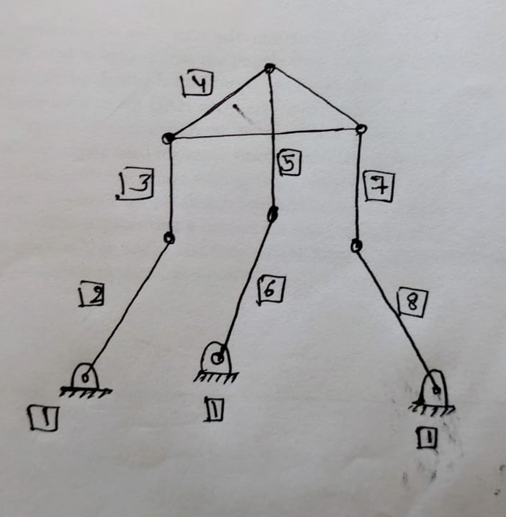
Kinematic Analysis
Degree of Freedom Calculation:
The ball balancing platform is a 3-DOF system (pitch, roll, and platform height)
For the ball: 2 translational DOF on the platform surface (x and y directions)
System has 3 actuators (servomotors) controlling 3 legs spaced at 120° intervals
Inverse Kinematics:
Servo angles are determined by the desired platform orientation (α, β)
Each servo elevation angle is calculated using:
servo_angles(i) = atan2d(L_vec(3), norm(L_vec(1:2)))
where L_vec is the vector from base joint to platform joint

Slide 5
Kinematic Synthesis
Platform Design Parameters
Joint Configuration: Base and platform joints arranged in triangular patterns with 120°spacing to provide balanced support and control
Link Length Optimization: 10cm links provide sufficient workspace while maintaining stability
Platform Height: Nominal height of 12cm balances stability with responsive movement
Control Strategy
Error Calculation: X and Y errors computed between desired and actual ball positions
PID Formulation:
beta_cmd = -(Kp*x_err + Kd*x_dot_err) % Pitch controlalpha_cmd = +(Kp*y_err + Kd*y_dot_err) % Roll control
Angle Limiting: Maximum tilt angles restricted to ±15° to maintain stability and operational safety

Slide 6
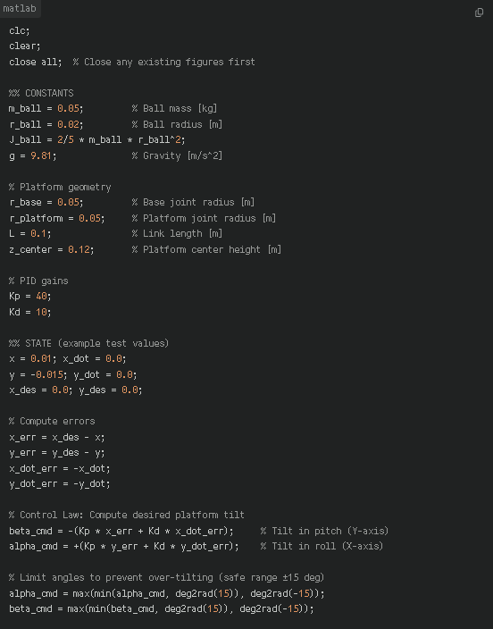
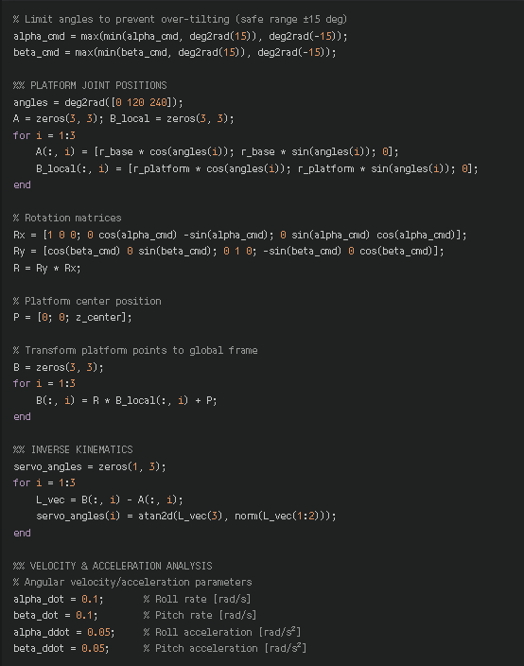
MATLAB CODE

Slide 7
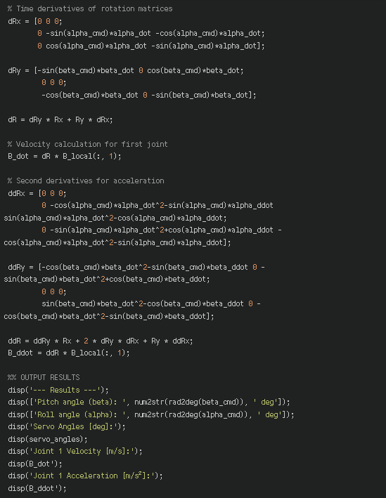
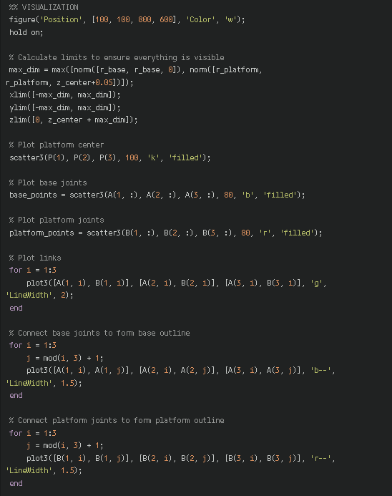

Slide 8
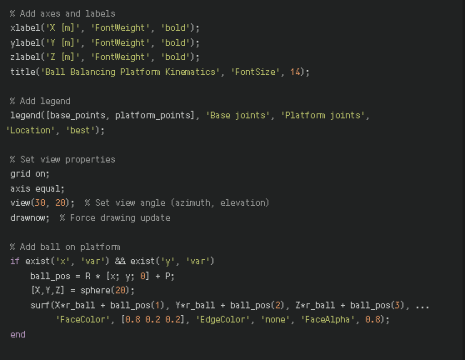
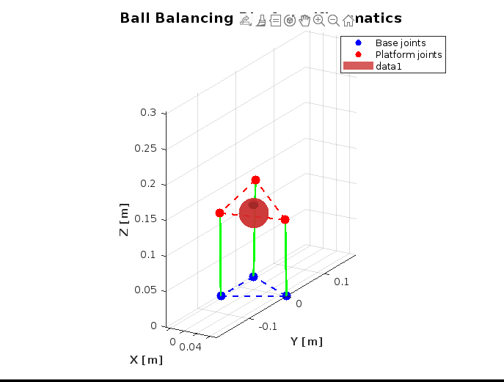
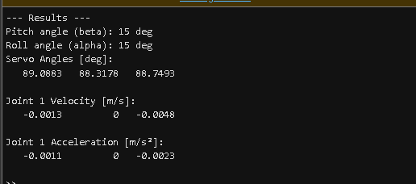

Slide 9
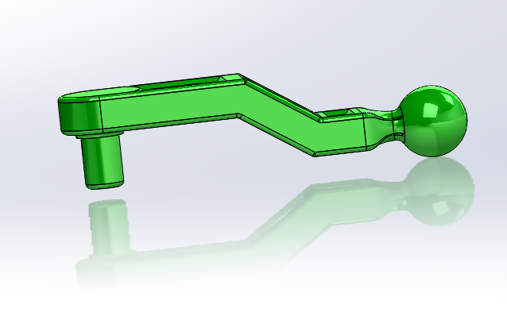
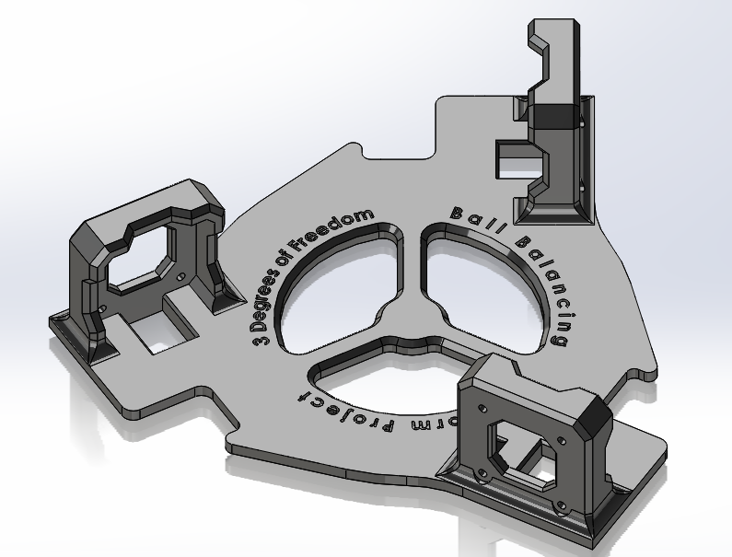
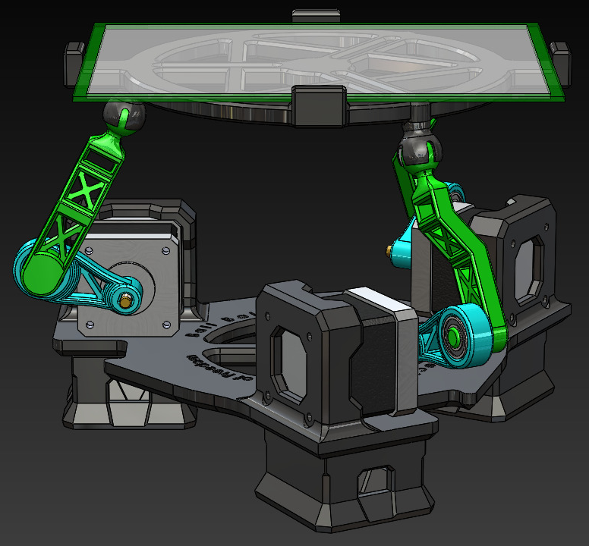
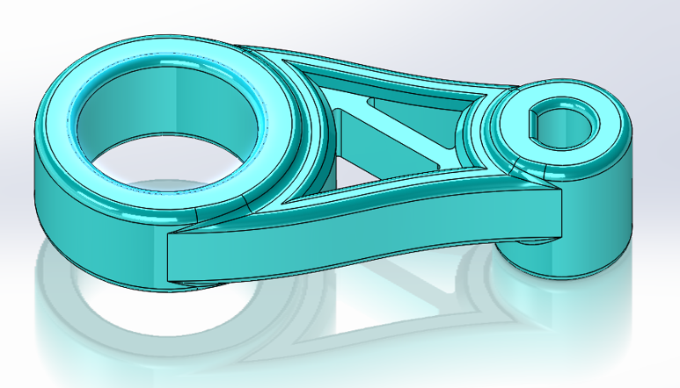
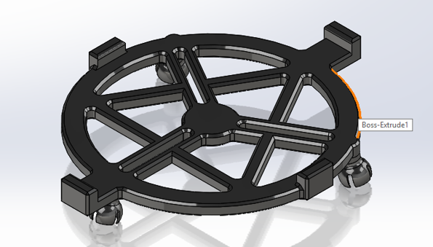
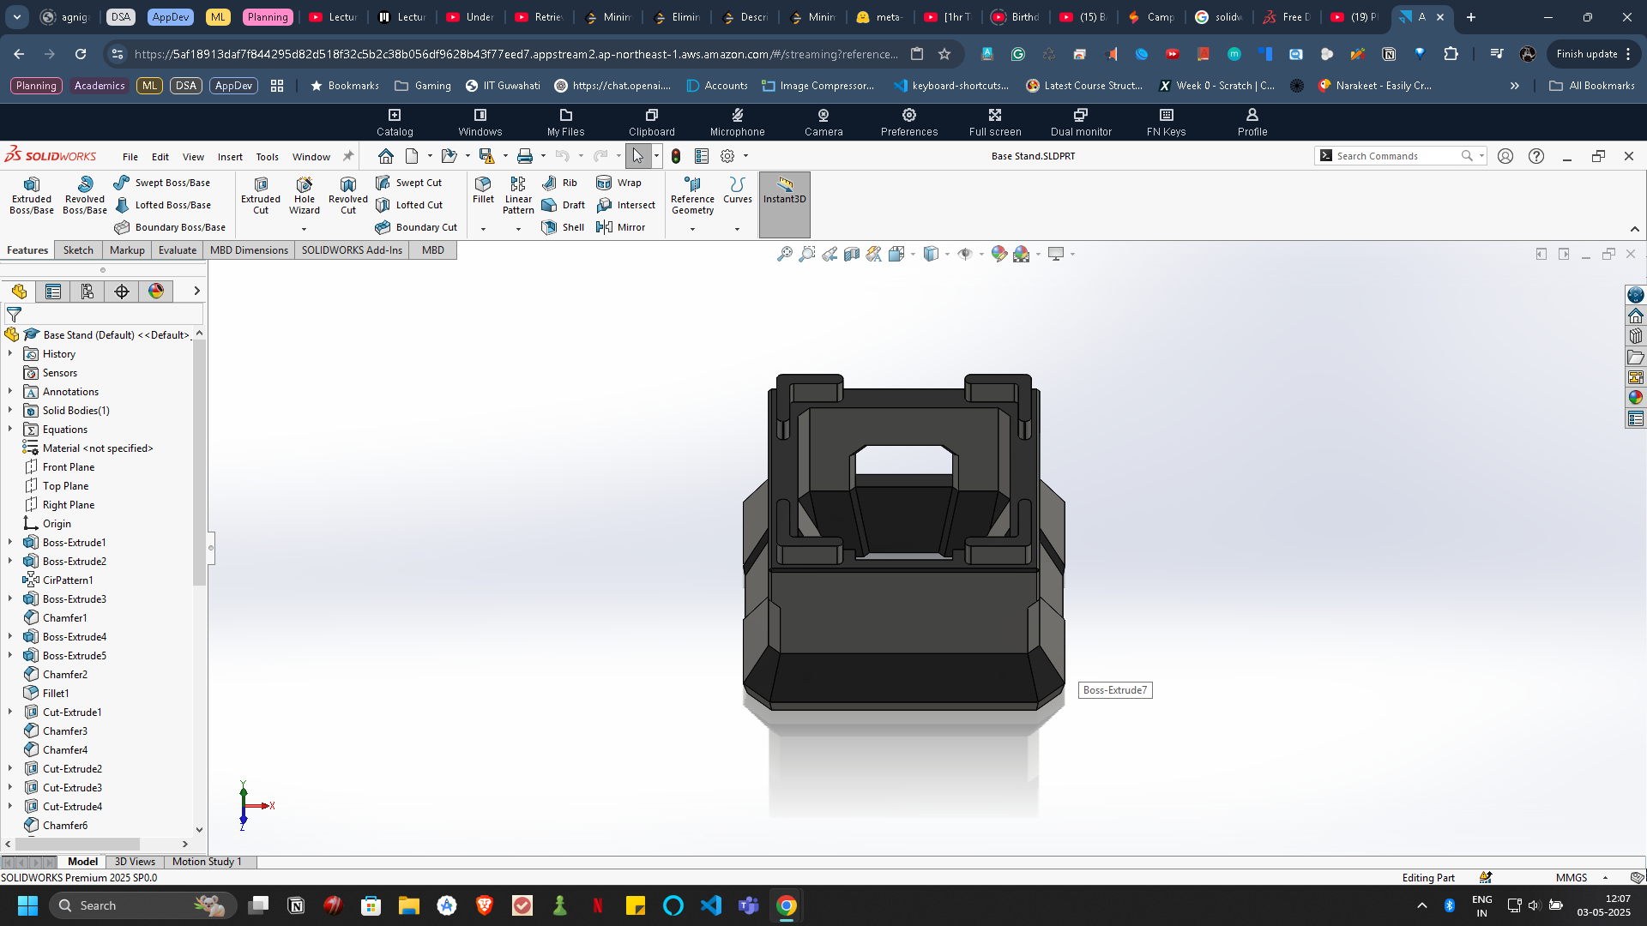
Computer Aided Design
Link
Motor Frame
Arm
Main Assembly
Top Platform Base
Base Support

Slide 10
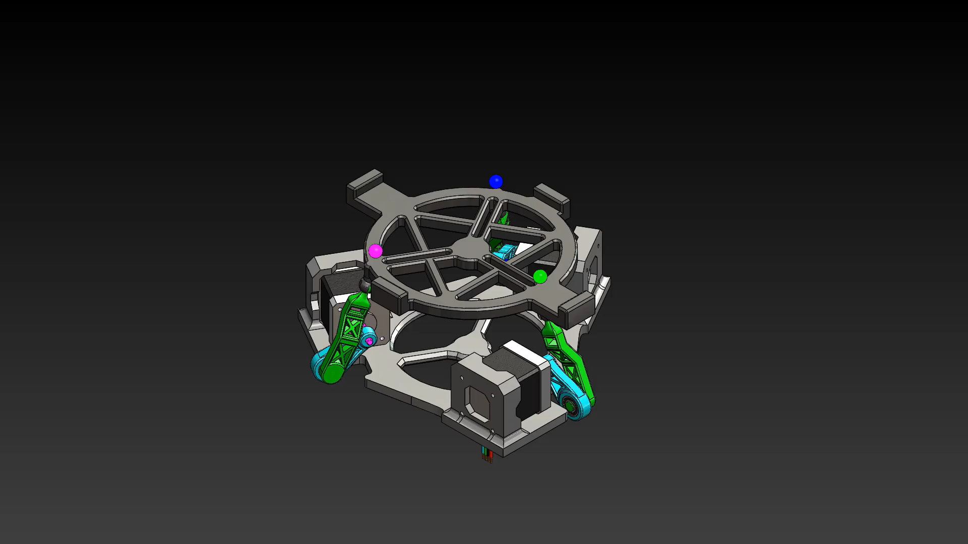
Motion Analysis / Study

Slide 11
Fabrication Details
Power
Battery holder (Li-ion/LiPo)
Voltage regulator module
Main switch + wiring channels
Electronics
Controller board mount (Arduino, Pi, STM32, etc.)
Sensor mounts (camera or IMU/IR)
Material Summary
Chassis: Acrylic, aluminium, or 3D printed PLA/ABS
Connectors: Standoffs, spacers, brackets
Mechanical
Base frame (aluminium/acrylic/3D printed)
Tilting platform (square or round)
Support columns
Actuator mounting arms
Actuators
2 or 3 servo/stepper motors
Motor mounts for secure attachment

Slide 12
Conclusions
This ball balancing robot implementation demonstrates:
Practical : Provides foundation for future enhancements like:
Control Theory: Successfully applies PID control to an inherently unstable, underactuated system
Sophisticated Kinematics: Implements complete inverse kinematics with velocity and acceleration analysis
Platform for Extension
Path planning and pattern following
Integration of additional sensors (IMU, encoders)
Implementation of alternative control strategies (LQR, sliding mode control)
Mobile platform applications
The project synthesizes concepts from dynamics, control theory, and computational methods, demonstrating both theoretical understanding and practical implementation skills that extend well beyond typical classroom assignments.

Slide 13
Thank You

